Slide 1
KBQA论文分享
谈川源

Slide 2
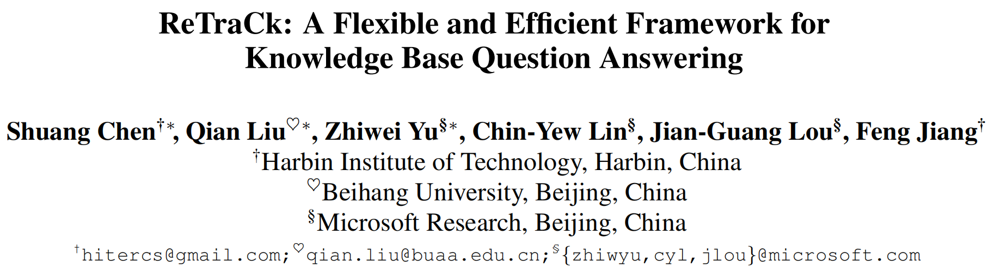

Slide 3
主要内容
标准且优秀的KBQA系统
balance 系统性能 与 时间成本
兼得 SOTA & Efficiency

Slide 4
背景介绍
Knowledge Base Question Answering (KBQA)
给定自然语言问题，通过对问题进行语义理解和解析，进而利用知识库进行查询、推理得出答案
Triple
Knowledge Graph
KB的一种，triples组成有向图
Predicate
Subject
Object

Slide 5
Semantic Parsing-based KBQA
通过对问句进行语义上的分析，转化成为一种能够让知识库“看懂”的语义表示，进而通过知识库中的知识，进行推理查询，得出答案。
Logic Form
KB能“看懂”的语义表示，即为逻辑形式
question ➔ Logic Form ➔ SPARQL

Slide 6
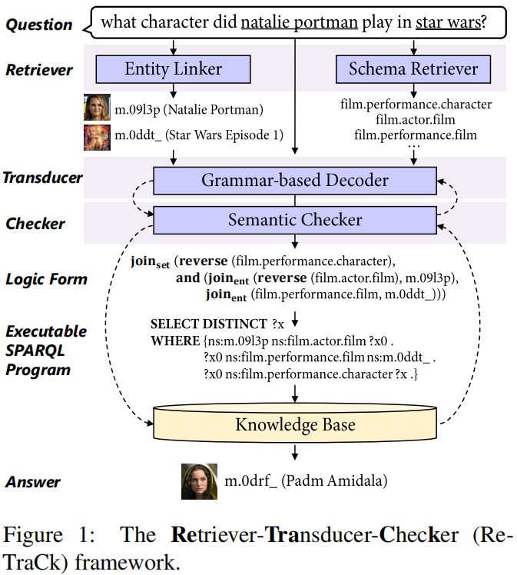
Framework
Retriever
Entity Linker
Schema Retriever
Transducer
grammar rules
Question Encoder
Grammar-based Decoder
Checker
Instance-level Checking
Ontology-level Checking
Real Execution
Virtual Execution

Slide 7
1.1 Entity Linker
Entity Detection (实体识别)
BERT-based NER
Candidate Generation (候选生成)
alias map + prior probability (KB& corpus)
Entity Disambiguation (实体消歧)
BOOTLEG + Prior
in: 风清扬对钱感兴趣么？
KG
花名
“风清扬”
马云
本名
登场作品
风清扬
笑傲江湖
out: 马云

Slide 8
1.1.3 Entity Disambiguation
BOOTLEG
BERT-based
entity ➔ JOIN(entity, types, relations)
BOOTLEG + Prior
2个score ➔ FC*2 ➔ ReLU

Slide 9
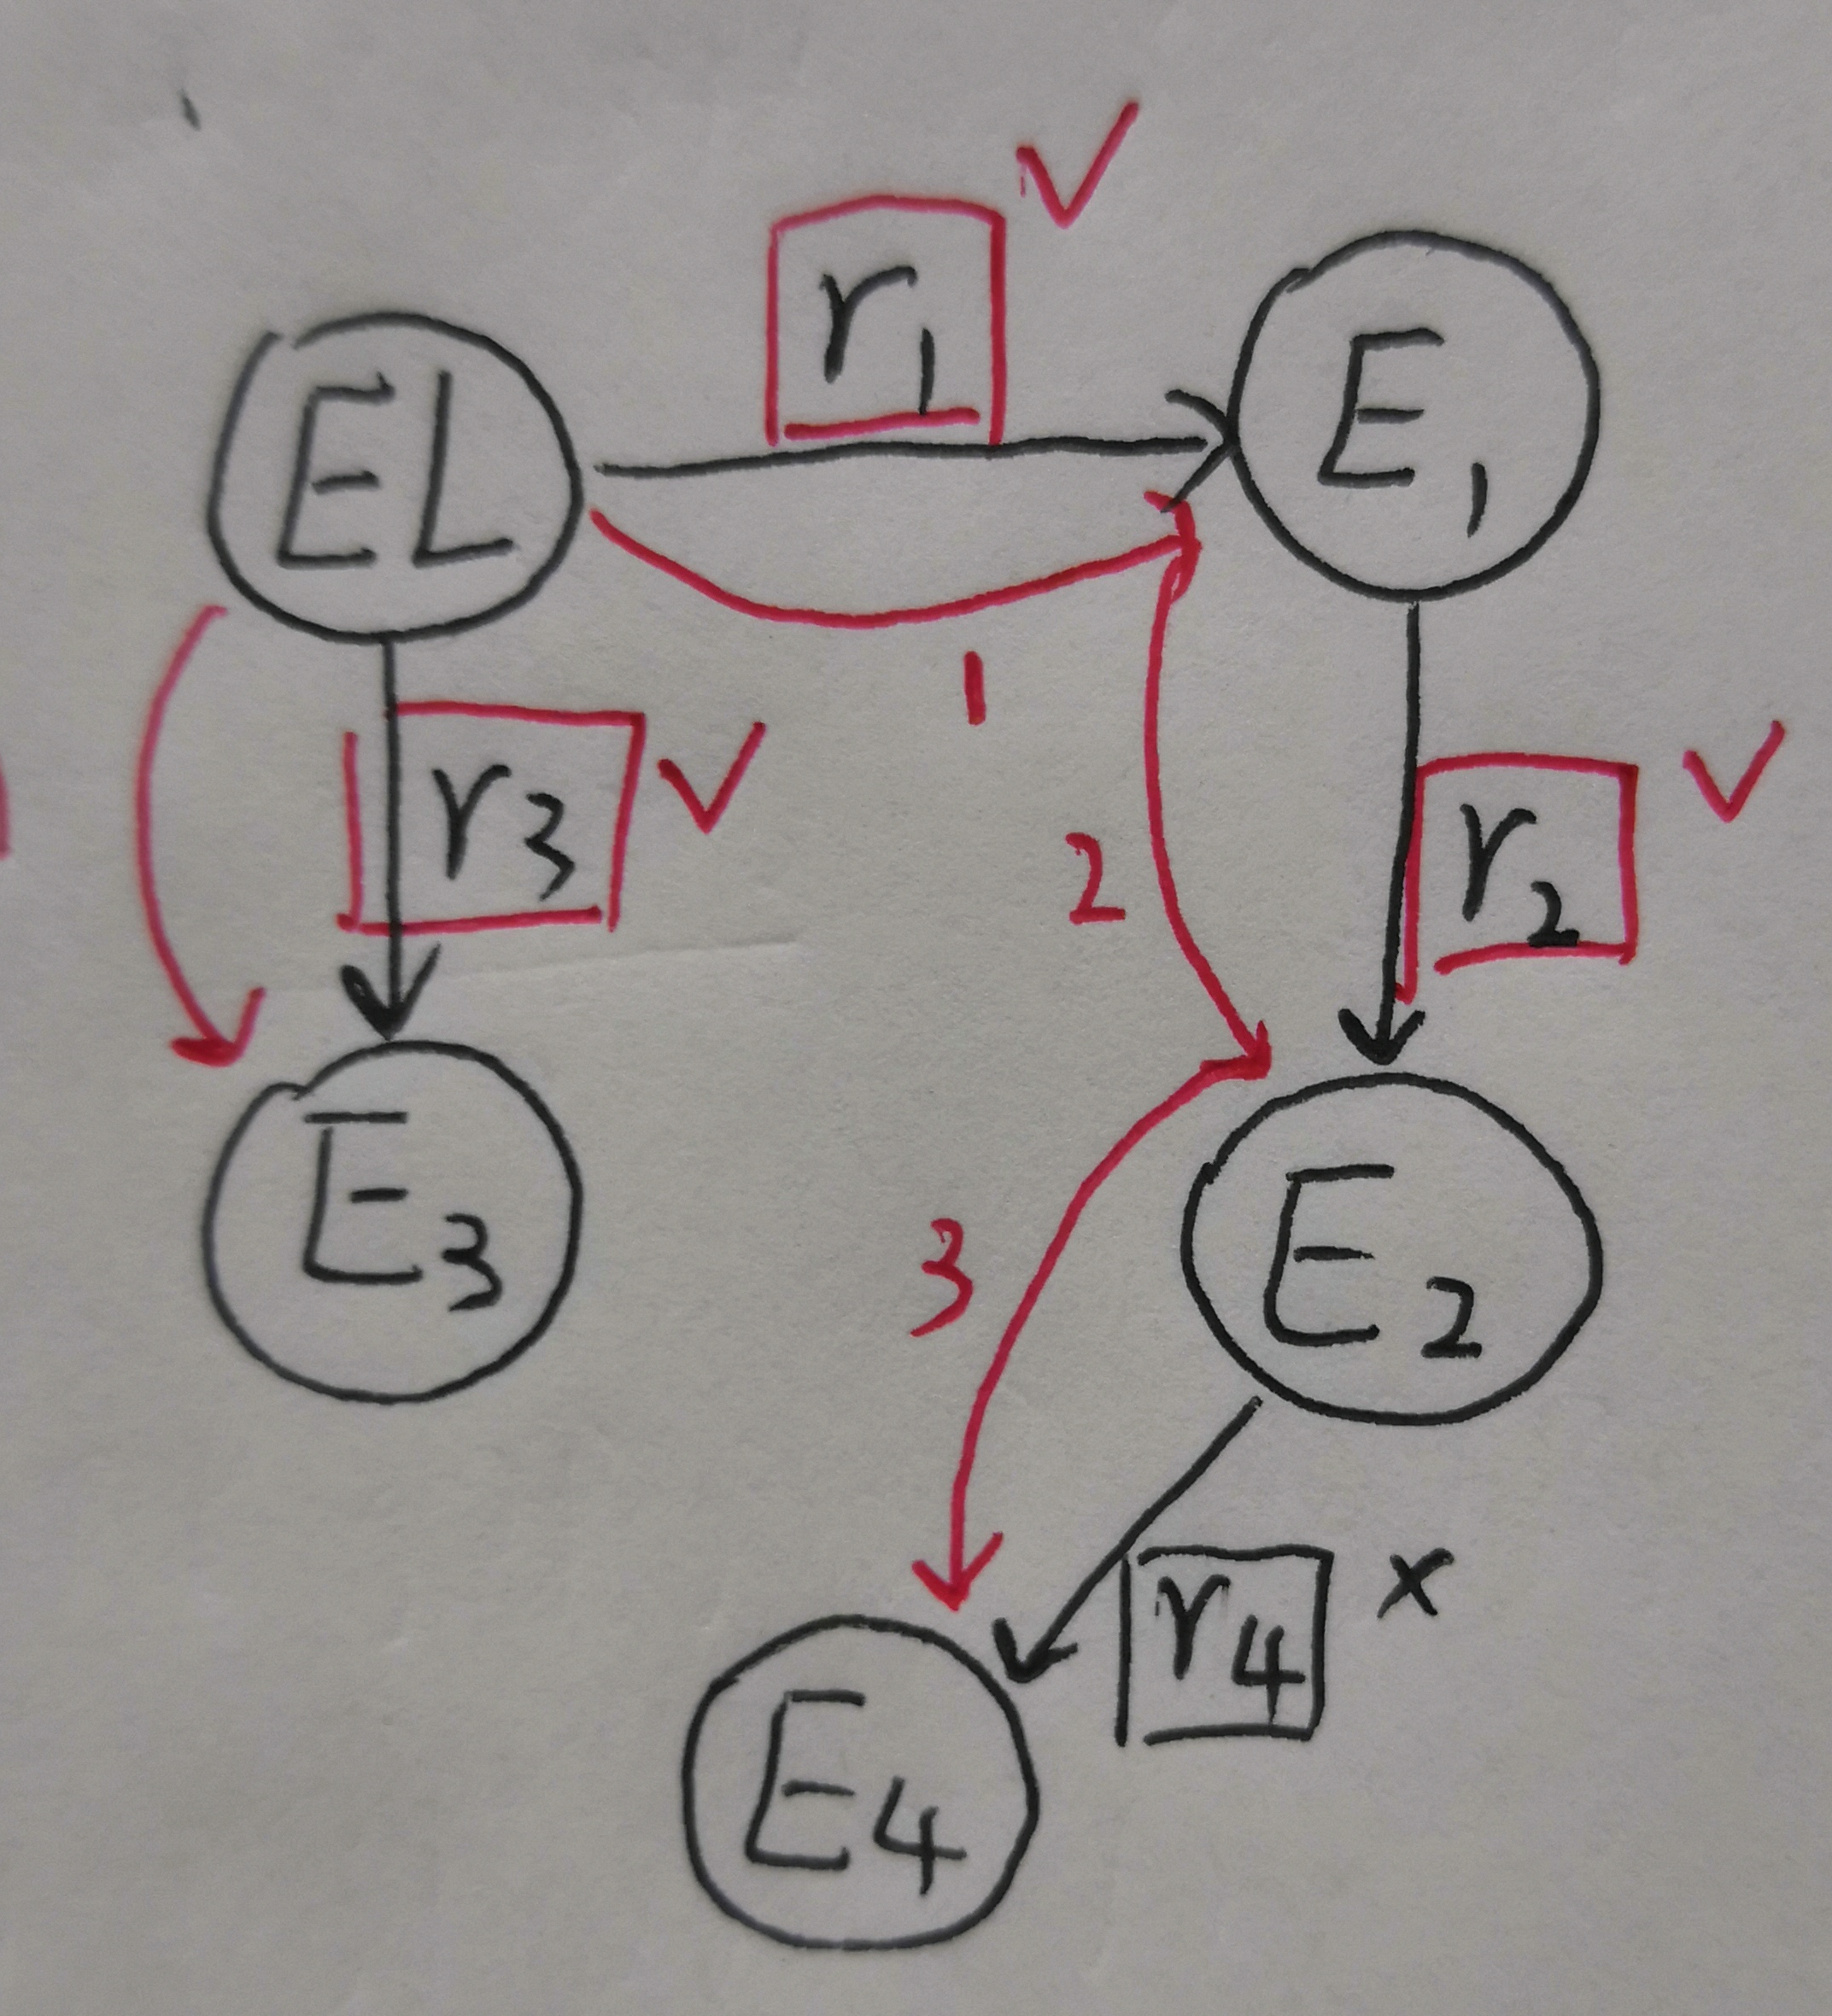
1.2 Schema Retriever
——Retrieve Schema item (Types & Relations)
(1) Neighbor Schema Retriever
以Entity Linker 找到的候选为起点，2 hop内召回
limit：
wait for EL
limited in 2 hop

Slide 10
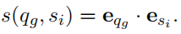
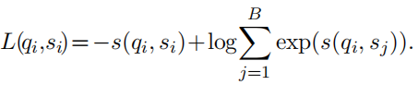
(2) Dense Schema Retriever
计算语义相似度 (dot)
in-batch negatives (批次内负采样)
e_{q}
e_{s}
(可提前计算)
For (q_{i}, s_{i}) the loss is computed as:
BERT
BERT
(B: batch_size)
CLS
question
CLS
schema item

Slide 11
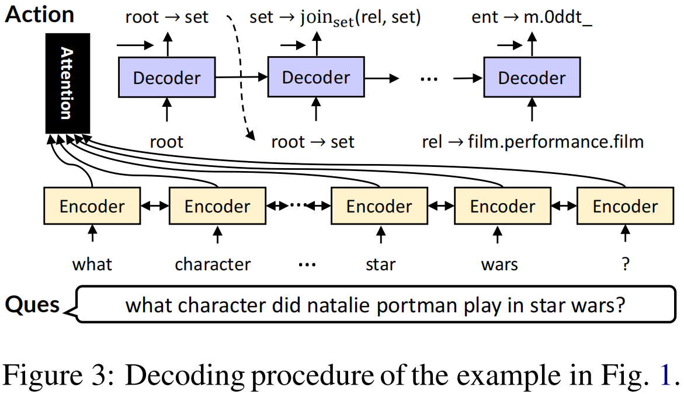
2. Transducer
Grammar Rules (语法规则)
Question Encoder (问句编码器)
Bi-LSTM Encoding
BERT Encoding
Grammar-based Decoder (语法解码器)

Slide 12
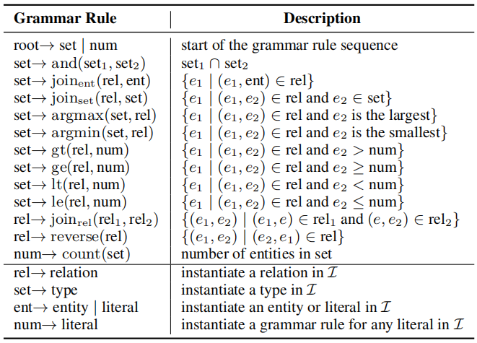
2.1 Grammar Rules
Knowledge-agnostic
Knowledge-specific
set: a set of entities
rel: the set of (head, tail) entity tuples

Slide 13
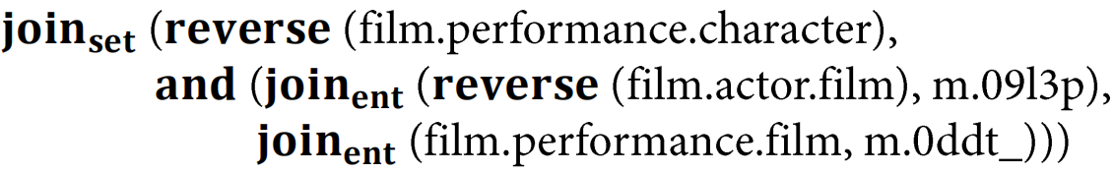
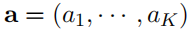
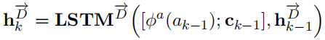

2.3 Grammar-based Decoder
Output:
hidden state of step k:
[embed of a_{k-1}; Attention]
predicting a_{k}:
(Wº: a learned matrix)

Slide 14
3. Checker
—with beam search
Instance-level Checking (实例级检验)
rel — ent ?
Ontology-level Checking (本体级检验)
Types & bridging relations
Real Execution (执行)
try to execute SPARQL over KB
Limit:
time consuming
can’t intervene in the middle of program generation
Virtual Execution (模拟执行)
is virtual answer set empty ?
Bottom-up at Ontology-level

Slide 15
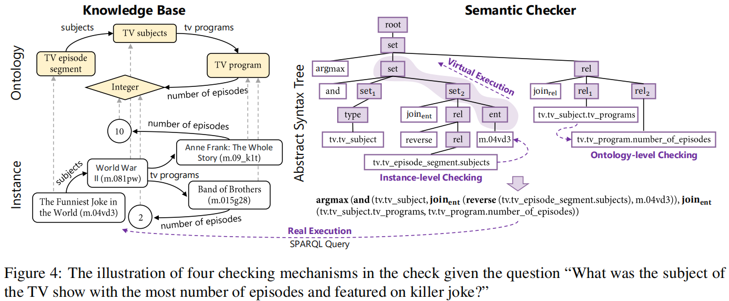
set: a set of entities
rel: the set of (head, tail) entity tuples

Slide 16
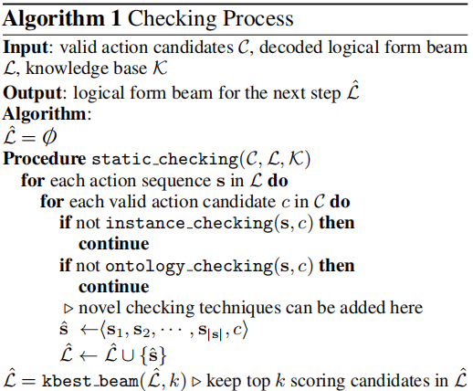
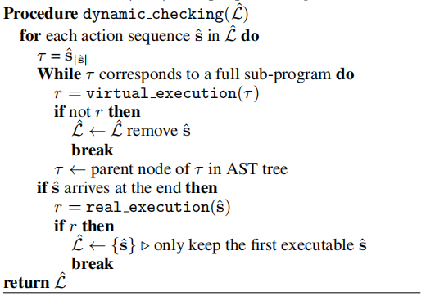

Slide 17
4. Experiments
GrailQA
question: 64,331
up to 4 relation
superlative, count, comparative
Levels of Generalization (in test)
i.i.d.: 25%
compositional: 25%
zero-shot: 50%
metrics: EM & F1
(exact match accuracy)
is logical form semantically equivalent?
WebQuestionsSP (WebQSP)
question: 4937
up to 2-hop relation path inference
metrics: F1 & Hits@1

Slide 18
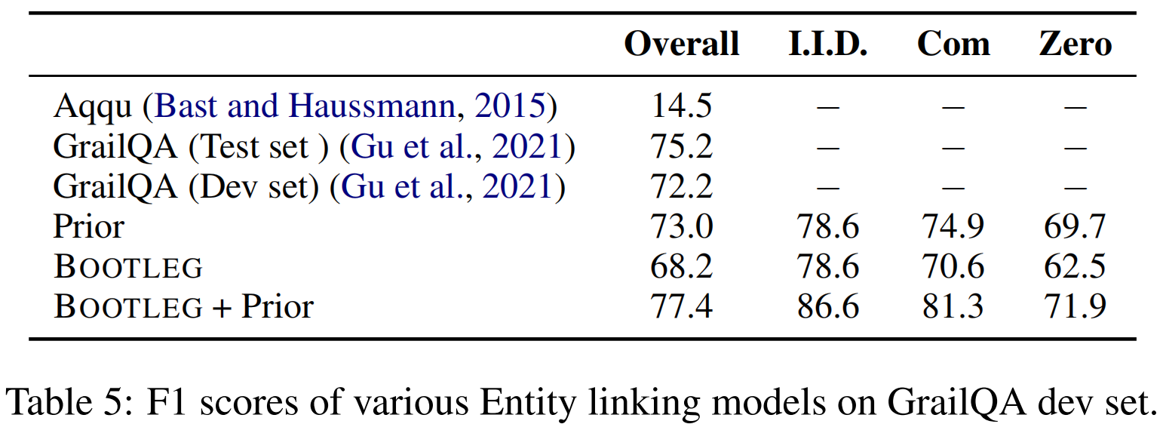
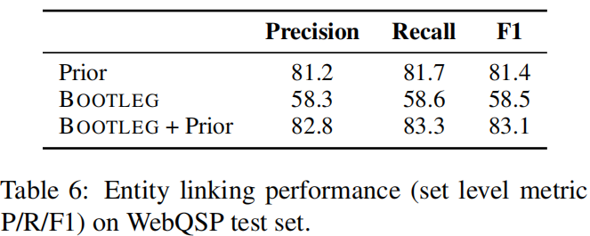
4.1 Entity Linker

Slide 19
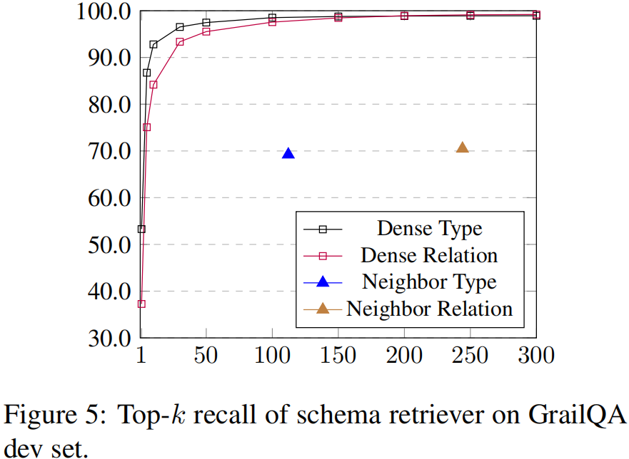
4.2 Dense Schema Retriever v.s. Neighbor Schema Retriever
recall
average candidate item

Slide 20
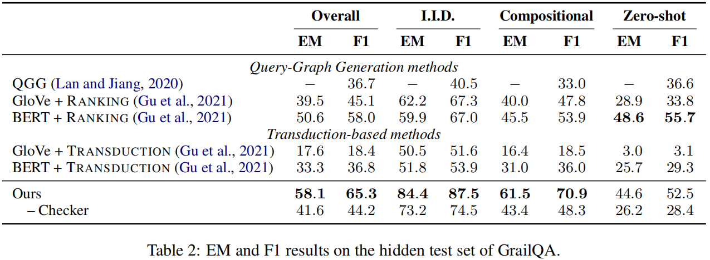
4.3 System Performance

Slide 21
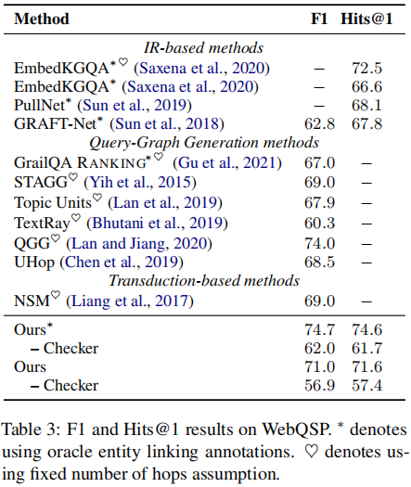

Slide 22
总结
Efficiency
Entity Linker，Schema Retriever 并行
Transducer , 预测概率
Virtual Execution (Checker)
Effectiveness
Checker记首功

Slide 23
References
背景介绍: 揭开知识库问答KB-QA的面纱
Shuang Chen, Qian Liu, Zhiwei Yu, et al. ReTraCk: A Flexible and Efficient Framework for Knowledge Base Question Answering (ACL 2021)

Slide 24
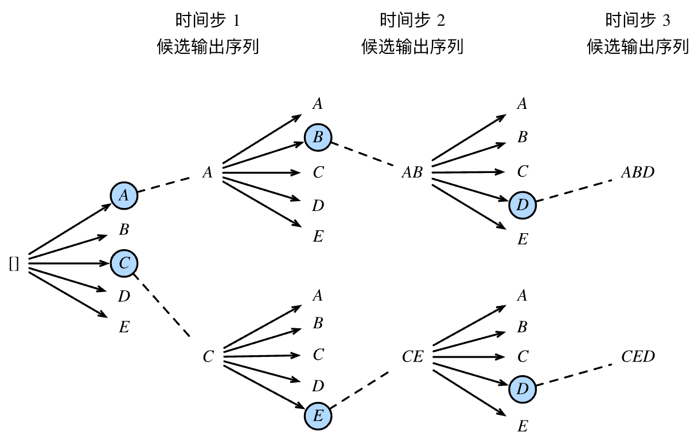
Beam Search
动手学深度学习》 10.10 束搜索

